Slide 1

Access Control Standards and Processes
Physical Security for 5G Networks
Video 8.2

Slide 2

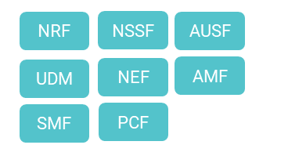


5G Physical Network
User
Equipment
Antenna
Remote Radio Unit
Far Edge
Cloud
Edge Cloud
Core Cloud
Large Cells
Small Cells
Hubs
Outside Plant
Central Office
Small Data Center
Large Data Center

Slide 3
Access Control Best Practices
5G Network Facilities
MFA Multi-factor authentication through more than one form of identification.
Interlocks Prevent tailgating and piggybacking, surveil entrances.
Zero Trust Layered approach to security and access, just what is needed to do job.
Access Lists Keep lists current for both technicians and contractors.
DCIM Tools Uses software to actively manage access and to monitor facilities.

Slide 4
Key Takeaways
01
Physical Security of 5G Important
Cell sites to Central Offices to Data Centers.
02
Access Control Best Practices
Zero Trust, MFA, Access Lists, Interlocks, DCIM.
03
Processes Need to Be Followed
Critical to protecting the network.

Slide 5
Systems Surveillance and Monitoring
Next Video

